Slide 1
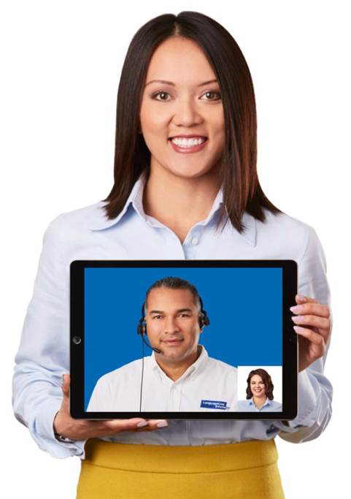
Optimizing
LanguageLine InSight®
Video Interpreting

Slide 2

Agenda
Why language access is important
Why LanguageLine Solutions
Managing cultural difference
Identifying the preferred language
How to access an interpreter
Working with the interpreter
Notes:
2

Slide 3

Why Language Access Services?
It’s the Right Thing to Do
Improves customer service and builds loyalty by communicating in the customer’s preferred language
Improves staff efficiency by streamlining the communication process
Mitigates risk and reduces the expense associated with a lack of effective communication

Slide 4

Why Language Access Services?
It’s The Law
The law requires recipients of Federal funds to provide free, professional language access services to the Limited English Proficient and the Deaf and Hard-of-Hearing and provide notification that services are available.
Section 1557 of the Patient Protection and Affordable Care Act
Executive Order 13166 of 2000
Americans with Disabilities Act of 1990
Section 504 of the Rehabilitation Act of 1973
Title VI of the Civil Rights Act of 1964
Local Language Access Mandates
Compliance helps us to:
  Provide an outstanding customer experience
  Avoid costly fines
  Maximize Federal funding
  Avoid the cost of litigation

Slide 5

Even More Regulated in Healthcare
The law requires recipients of federal funds to provide free, professional language access services to the Limited English Proficient and the Deaf and Hard-of-Hearing and to provide notification that service is available.
Executive Order 13166 of 2000
The Joint Commission
Culturally and Linguistically Appropriate Services (CLAS) Standards
Section 1557 of the Patient Protection and Affordable Care Act
  Bans the use of low-quality VRI
  Requires qualified interpreters
Benefits to patients:
  Improves health outcomes
  Reduces readmissions
  Contributes to outstanding patient experience

Slide 6










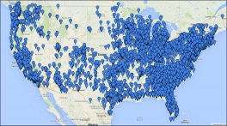
The Industry’s Most Dependable Provider
THE PREMIER PARTNER
Quality Linguists
Only 1 in 11 (9%) applicants hired
Ongoing training and support
Quality assurance and monitoring
Average annual investment in our linguists exceeds many of our competitors annual earnings
Systems Safety and Security
Complete hundreds of security and business continuity client audits annually in Finance, Insurance, Healthcare, Utilities, Government sectors
True global comprehensive Insurance and
Liability Policy
Financial Stability
More than 3x revenue of our nearest competitor*
Sustained growth with annual revenue increases
Technological Innovation
Single largest technology investment in the history
of the language industry to support client needs
Faster, clearer connections to interpreters
New cutting edge solutions
THE TRUSTED PARTNER
Experienced
Clients
Client Retention
28,000
99%
THE PROVEN PARTNER
13 of the top 14
Medical Facilities
18 of the top 20
Insurance Companies
8 out of the top 10 Commercial Banks
1000s of Government Agencies
* 2018 Common Sense Advisory

Slide 7

Managing Cultural Difference
Interpreters help overcome language and cultural barriers.
When working with LEP persons keep in mind:
Cultural Sensitivity. An LEP’s culture, traditions and experiences may be very different from our own. Understand differences exist. Be non-judgmental.
Indirect Communication. English is a direct language. In other languages and cultures, it often takes longer to get to the point—even during emergencies. Understand this issue and be patient.
Education. LEP persons may not be familiar with practices common to us. To improve communication and reduce confusion, offer explanations when possible to bring LEP customers into the mainstream.
Simple Language. To improve understanding, use simple language and ask for clarification if needed.
Your Manner. Be respectful and speak in a neutral tone.
Notes:
7

Slide 8
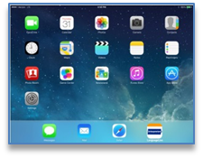

Accessing the InSight Application
On the iPad/Tablet
  Tap on the InSight icon to open the application.
On the PC/Laptop
  Double Click on the InSight icon to open the application.

Slide 9
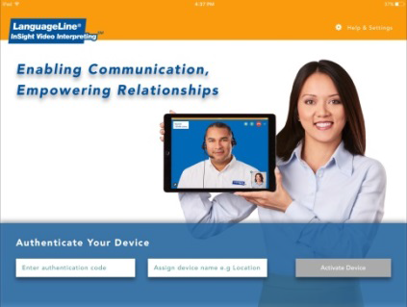
One Time Authentication
Enter the Authentication Code provided to you by LanguageLine.
Name your device (identifies location, department, or person). The device name will appear on your usage report and invoice.
Tap on Activate Device to complete authentication.
Once completed, the application will open directly to the language selection screen.

Slide 10
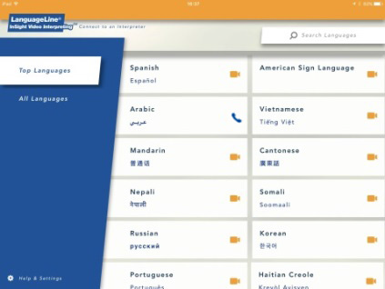


InSight Language Selection Screen
The app opens in “Top Languages” to access the 36 languages including American Sign Language
Languages appear in English and
in-language
Scroll to view more languages
Dynamic language display adjusts to your usage
Icons dynamically adjust with language schedule to match video schedule
Search Languages feature allows searches by language or country
Available Video
Available Audio

Slide 11
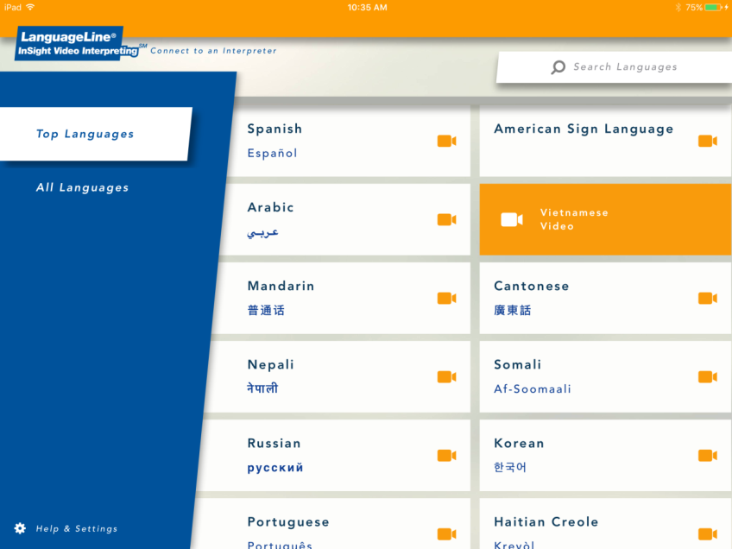

Accessing a Video Interpreter
Tap the language to select-the language will turn orange
Tap the orange highlighted language with video icon to access a video interpreter
While connecting to the interpreter, a full view allows for proper positioning of the iPad
Greet your interpreter

Slide 12
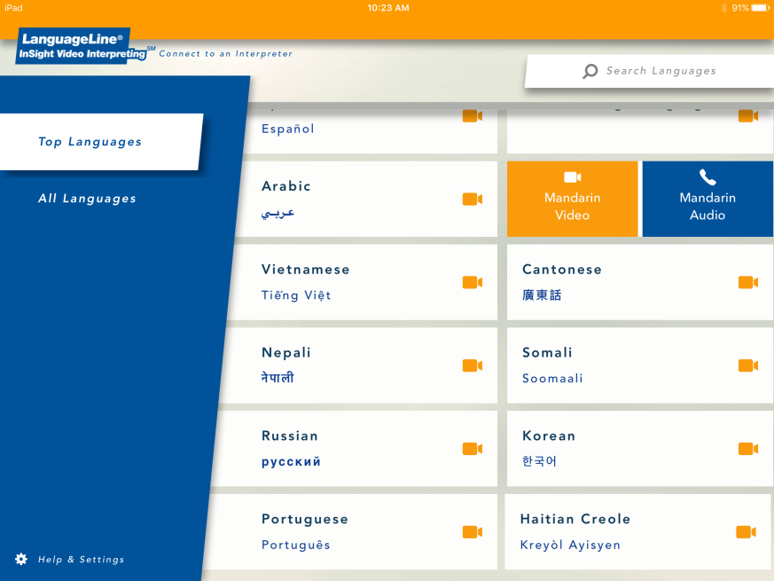

Accessing a Video Interpreter
Tap the language to select-the language will turn orange for video and blue for audio
Tap the orange box with video icon to access a video interpreter
Tap the blue box with phone icon to access an audio only interpreter
While connecting to the interpreter, a full view allows for proper positioning of the iPad
Greet your interpreter

Slide 13
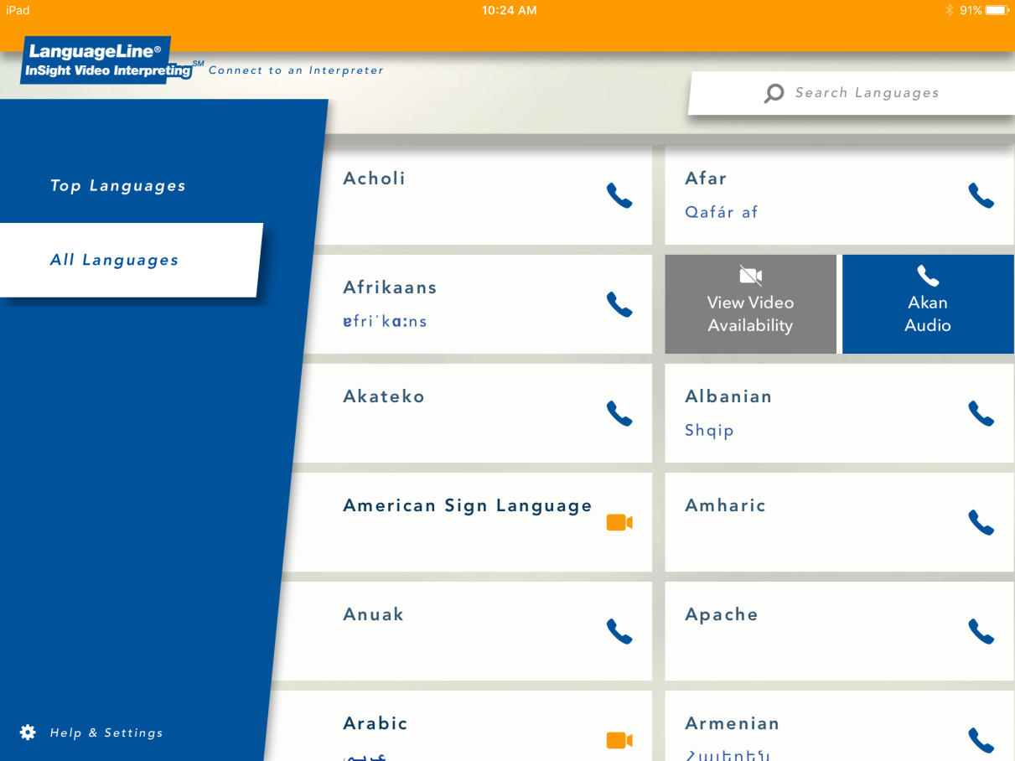
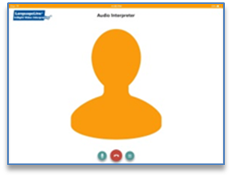

Accessing an Audio Interpreter
Tap to end the call
Choose All Languages and tap the language to select
Tap the blue highlighted language with phone icon to access an audio interpreter
An image icon appears onscreen and your audio interpreting session begins

Slide 14
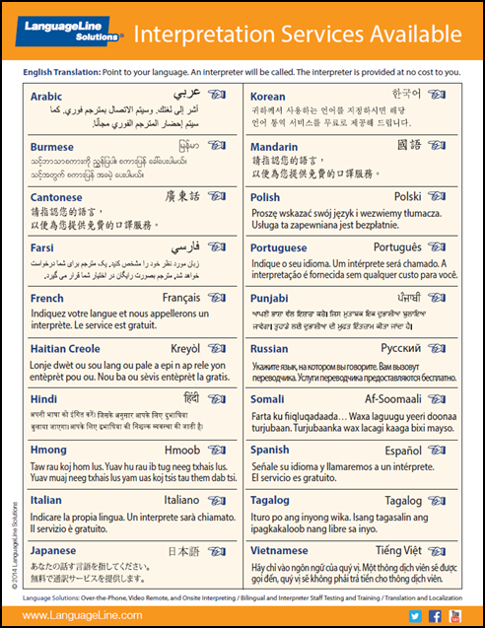


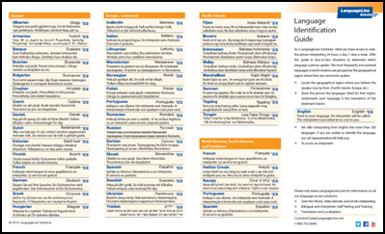
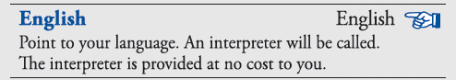
Identifying the Language Preference
Language identification tools are available to enable limited English speakers to point to their preferred language. If a language still can not be identified, call an interpreter for language identification assistance.
Desktop Display
Language ID Guide
Language ID Poster
This phrase is translated into each language for self-identification.

Slide 15
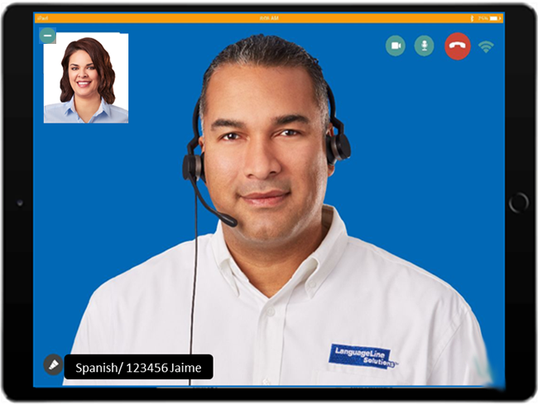

Working with the Interpreter
Brief and update the interpreter
  Introduce yourself and state the goal of the encounter.
  Position the device so the interpreter and the individual can see each other.
Communicating with the customer
  Retain control of the call. The interpreter will assist with communication, but you drive the conversation.
  Use direct speech (first person) at all times. “How are your today?”
  Speak in short sentences, using 3-5 sentence segments and pause at the end of a thought.
  Avoid jargon, slang and complicated technical terminology.
  If you sense that the customer does not understand, try to rephrase or explain in a different manner or repeat what you have heard.
  Remember, whatever the interpreter hears will be
  interpreted. Avoid private conversations.
Closing the conversation
  Check with the customer for understanding.
  Document that you worked with an interpreter,
  include the interpreter name and ID #.
  This is especially important in healthcare situations.
Notes:
15

Slide 16
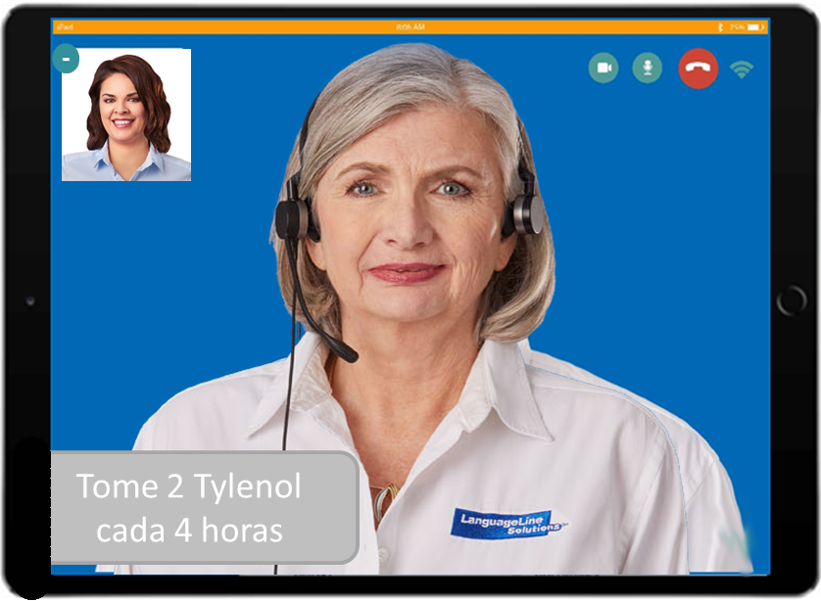
NotePad Feature
Text can emphasize key information you would like the customer to understand and remember.
To use the NotePad:
  Ask the interpreter to bring up the NotePad
  State what you want typed on the screen
  Keep the information concise
  The interpreter will type in the target language
Note: the NotePad feature may not be available for all languages at all times

Slide 17
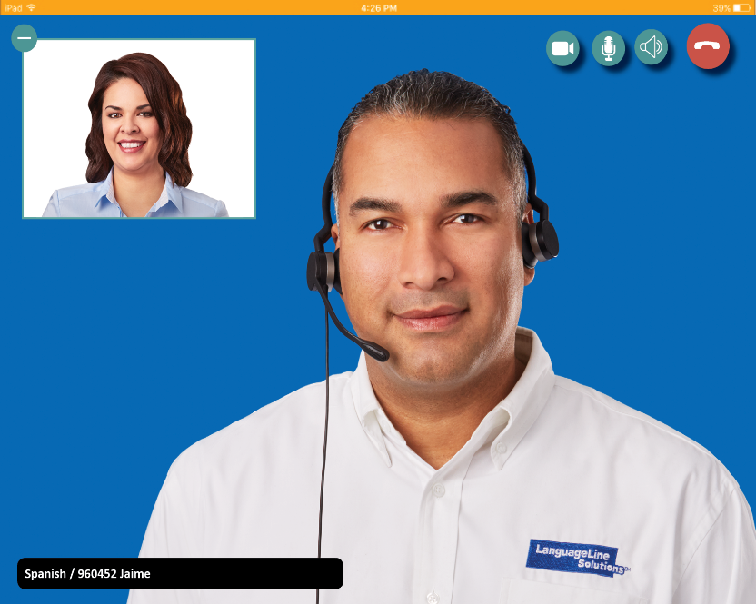





Navigating the InSight Tap Control Buttons
-
Minimize or move the self-video window or drag the image to a different location
Allow video privacy so the interpreter does not have video access
Mute and un-mute audio
End the call
Access the in-app volume adjustment

Slide 18
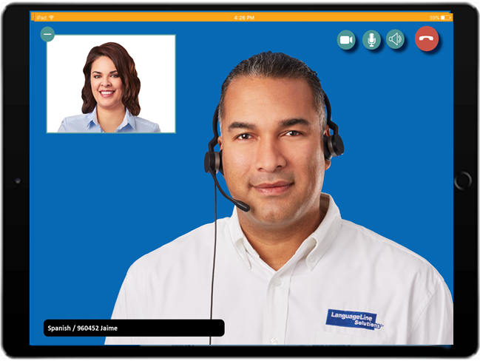
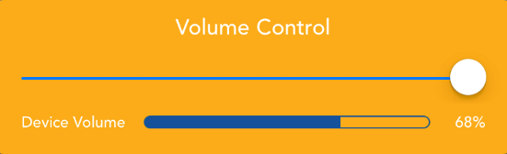
Volume Adjustment
During an active InSight call, turn up the iPad volume to the highest setting using the iPad’s volume button. Next tap the volume icon to view the in-app Volume Adjustment Slider bar and adjust the volume to the desired setting.

Slide 19
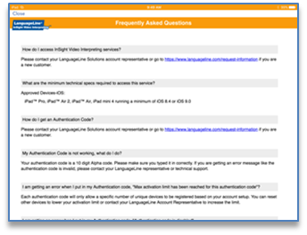
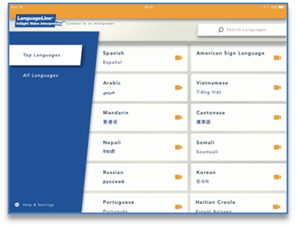
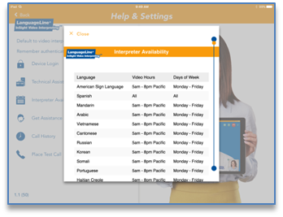
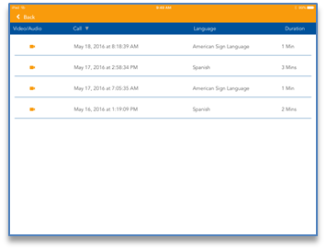
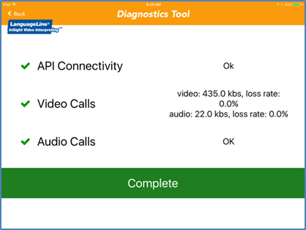
Access Help & Settings
Tap “Technical Assistance” to review a list of the most frequently asked questions and easy to understand responses with suggested actions.
Select “Interpreter Availability” to access the video interpreter schedule including the language, hours of video interpreter availability, and days of the week
Tap “Call History” for a 30-day call history for this device including: video or audio call, date and time, language, and the duration of the session.
Tap “Network Diagnostics” to help troubleshoot connectivity issues.
Tap Help & Settings

Slide 20
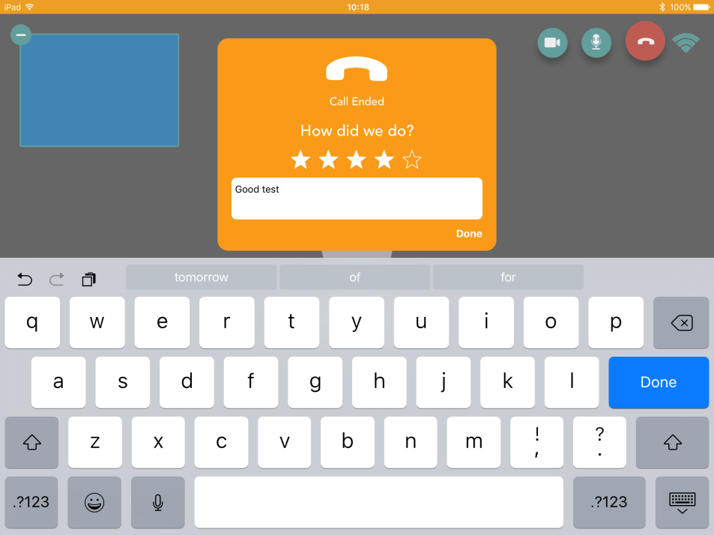
At the End of Each Call…How Did We Do?
Option to rate your experience after every call
Tap 1-5 Stars – 5 is the best
Enter brief comments
Does not replace the VOC
No charge to our account
On iPads only

Slide 21


LanguageLine Customer Service
24/7 InSight Technical Service
In you are having problems accessing an interpreting session contact:
InSight Technical Support 844.373.1951
Voice of the Customer:
If you wish to submit a comment or feedback to LanguageLine, visit their website at www.languageline.com and mouse over Client Services and click on Voice of the Customer. You may submit a Voice of the Customer (VOC). They welcome your communication.
Notes:
21

