Slide 1
Optimizing Phone Interpreting Services

Slide 2
Agenda
Why language access is important.
Why LanguageLine Solutions.
Identifying the preferred language.
Managing cultural difference.
How to access an interpreter.
Working with the interpreter.
Notes:
2

Slide 3
Why Language Access Services?
It’s the Right Thing to Do
Improves customer service and builds loyalty by communicating in the customer’s preferred language.
Improves staff efficiency by streamlining the communication process.
Mitigates the risk and reduces the expense associated with a lack of communication.

Slide 4
Why Language Access Services: It’s The Law
The law requires recipients of Federal funds to provide free, professional language access services to limited English proficient and the Deaf and Hard-of-Hearing people and provide notification that service is available.
Title VI of the Civil Rights Act of 1964.
Section 504 of the Rehabilitation Act of 1973.
Title lll of the Americans with Disabilities Act of 1990.
Local Language Access Mandates.
Compliance is mandatory!
Provide outstanding customer experience.
Avoid costly fines.
Maximize Federal funding.
Avoid cost of litigation.

Slide 5
Why Language Access Services: It’s The Law And Even More So in Health Care
The law requires recipients of federal funds to provide free, professional language access services to limited English proficient and the Deaf and Hard-of-Hearing persons and to provide notification that service is available.
Executive Order 13166 2000
The Joint Commission
Culturally and Linguistically Appropriate Services (CLAS) Standards
Section 1557 of the Affordable Care Act
Compliance is mandatory!
Provide an outstanding patient experience
Avoid costly fine.
Maximize Federal funding
Avoid cost of litigation

Slide 6
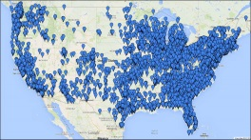
The Industry’s Most Dependable Provider
THE PREMIER PARTNER
Quality Linguists
Only 1 in 11 (9%) applicants hired
Ongoing training and support
Quality assurance and monitoring
Average annual investment in our linguists exceeds many of our competitors annual earnings
Systems Safety and Security
Complete hundreds of security and business continuity client audits annually in Finance, Insurance, Healthcare, Utilities, Government sectors
True global comprehensive Insurance and Liability Policy
Financial Stability
More than 3x revenue of our nearest competitor*
Sustained growth with annual revenue increases
Technological Innovation
Single largest technology investment in the history of the language industry to support client needs
Faster, clearer connections to interpreters
New cutting edge solutions
THE TRUSTED PARTNER
Experienced
Clients
Client Retention
28,000
99%
THE PROVEN PARTNER
13 of the top 14
Medical Facilities
18 of the top 20
Insurance Companies
8 out of the top 10 Commercial Banks
1000s of Government Agencies
* 2018 Common Sense Advisory

Slide 7
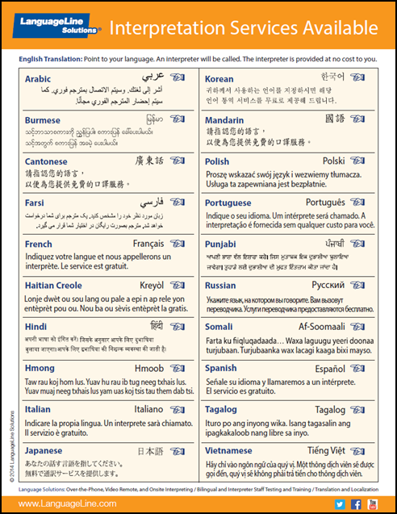
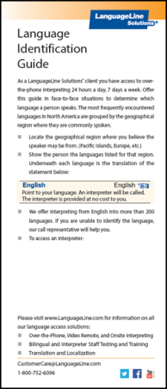
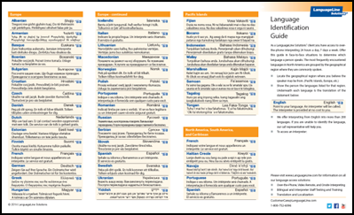
How to Identify a Language Preference
Language identification tools are available to enable limited English speakers to point to their preferred language. If a language still can not be identified, call an interpreter for language identification assistance.
Desktop Display
Language ID Card
Language ID Poster
This phrase is translated into various languages for limited English speakers self-identification.

Slide 8
Managing Cultural Difference
Interpreters help overcome language and cultural barriers.
When working with LEP persons keep in mind:
Cultural Sensitivity. An LEP’s culture, traditions and experiences may be very different from our own. Understand differences exist. Be non-judgmental.
Indirect Communication. English is a direct language. In other languages and cultures, it often takes longer to get to the point—even during emergencies. Understand this issue and be patient.
Education. LEP persons may not be familiar with practices common to us. To improve communication and reduce confusion, offer explanations when possible to bring LEP customers into the mainstream.
Simple Language. To improve understanding, use simple language and ask for clarification if needed.
Your Manner. Be respectful and speak in a neutral tone.
Notes:
8

Slide 9
Working with the Interpreter
Brief and update the interpreter
Introduce yourself and state the goal of the encounter.
Communicating with the customer
Retain control of the call. The interpreter will assist with communication, but you drive the conversation.
Use direct speech (first person) at all times. “How are your today?”
Speak in short sentences, using 3-5 sentence segments and pause at the end of a thought.
Avoid jargon, slang and complicated technical terminology
If you sense that the customer does not understand, try to rephrase or explain in a different manner or repeat what you have heard.
Remember, whatever the interpreter hears will be interpreted. Avoid private conversations.
Closing the conversation
Check with the customer for understanding
Document that you worked with an interpreter, include the interpreter name and ID #. This is especially important in healthcare situations.
Notes:
9

Slide 10
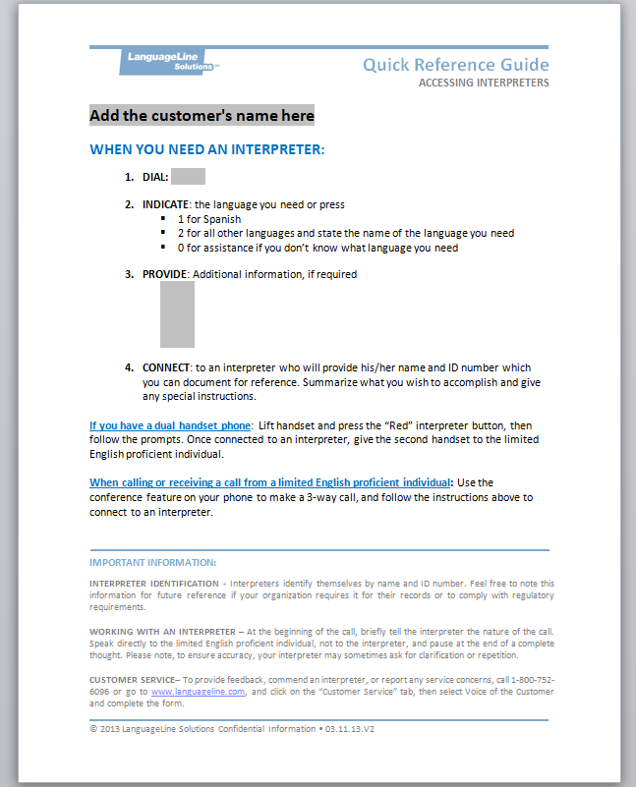
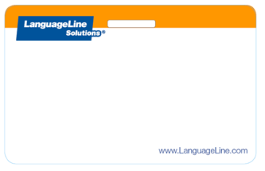
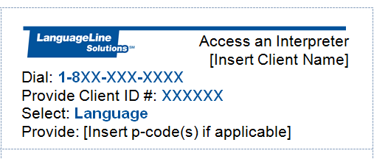
Access Support Materials for Staff
Quick Reference Guides (QRGs) include LanguageLine toll free number, Client ID#, and instructions for accessing an interpreter.
Notes:
10

Slide 11
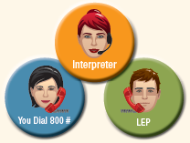
Accessing a Phone Interpreter
Receiving an INBOUND Call From an LEP:
Place the LEP on hold using the conference hold button.
Dial the LanguageLine toll free service number or hit the pre-programmed button to connect with LanguageLine.
Follow the IVR prompts or supply the information requested by the call agent.
An interpreter will be connected to the call.
Brief the interpreter. Summarize what you wish to accomplish and give any special instructions.
Add the LEP caller on the line.
Say “end of call” to the interpreter to complete the call.
Helpful Tip: If you are unable to identify the language, call LanguageLine call agents for help.
Notes:
11

Slide 12
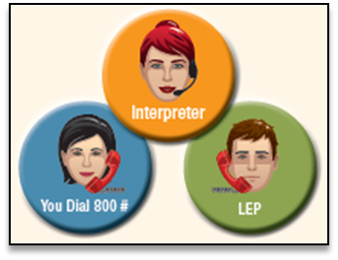
Accessing a Phone Interpreter
Placing an OUTBOUND Call to an LEP:
Dial the LanguageLine toll free service number or hit the pre-programmed button to connect with LanguageLine.
Follow the IVR prompts or supply the information requested by the call agent.
Brief the interpreter. Summarize what you wish to accomplish and give any special instructions.
Ask the interpreter to dial the LEP or place the interpreter on hold and conference in the LEP.
Say “end of call” to the interpreter to complete the call.
Helpful Tip: If you are unable to identify the
language, call LanguageLine call agents for help.
Notes:
12

Slide 13
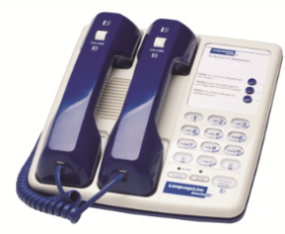
Accessing an Over-the-Phone Interpreter
When You Are Face-to-Face With an LEP
You may pass the phone handset back and forth, use a speakerphone, or use the LanguageLine Dual Handset phone.
Dial the LanguageLine toll free service number or hit the pre-programmed button to connect with LanguageLine.
Follow the IVR prompts or supply the information requested by the call agent.
Brief the interpreter. Summarize what you wish to accomplish and give any special instructions.
Say “end of call” to the interpreter to complete the call.
LanguageLine Dual Handset Phone
Helpful Tip: If you are unable to identify the language, call LanguageLine call agents for help.
Notes:
13

Slide 14
LanguageLine Customer Service
Customer Service:
LanguageLine is available for assistance for all services. If you need help with product information or support:
By Phone: 1-800-752-6096, option 2 - 6AM - 6PM PST Mon-Fri
By Email: customercare@languageline.com
Voice of the Customer:
If you wish to submit a comment or feedback to LanguageLine, visit their website at www.languageline.com and mouse over Customer Service and click on Provide Feedback. You may submit a Voice of the Customer (VOC). They welcome your communication.
Notes:
14

Slide 15
Language Access at All Touch Points
WRITTEN
LanguageLine® TranslationSM
Brochures/Manuals/Forms/Claims
Vital Documents/Contracts
Technical Publications
Marketing Materials
LanguageLine® Clarity℠
LanguageLine® LocalizationSM
Websites and Online Applications
Multimedia
Training Materials/eLearning
Software
BILINGUAL/INTERPRETER TESTING AND TRAINING
LanguageLine® Testing℠
Language Proficiency Testing
Employment Candidates
Front Line Staff
Call Agents
Interpreter Skills Testing
In-house Interpreters
LanguageLine® Training℠
Interpreter Skills
Medical and Court
SPOKEN AND SIGNED
LanguageLine InSight Video Interpreting®
On-demand video in 36 languages including ASL*
Audio-only in 240+ languages 24/7/365
Challenging situations benefitting from visual cues and facial expressions
Situations typically lasting 60 minutes or less
Fast mobile access with InSight for Smartphones
LanguageLine® PhoneSM Interpreting
On-demand access in 240+ Languages 24/7/365
Standard situations, typically lasting 15 minutes or less
Custom call flows
Direct ResponseSM fields inbound calls, in-language
Fast mobile access with the InSight for Smartphones
LanguageLine® OnSiteSM Interpreting
By appointment in 95+ languages and ASL*
Complex, critical, sensitive situations
Group meetings/conferences/conventions
Sessions lasting 60 minutes or longer
Personal InterpreterSM
On demand access from any phone
No Contract. No Fees. No Minimum. No Hassle.
Credit card billing – pay by the minute
Instant access to 240+ languages 24/7/365
Bridge Language and Cultural Barriers
Improve Productivity / Maximize Revenue / Decrease Expense / Enhance Image
Boost Customer Service / Build Loyalty / Comply with Regulations and Laws
* American Sign Language

